Slide 1


Debugging
with
Linaro DDTx

Slide 2
Website: www.rc.colorado.edu
Documentation: https://curc.readthedocs.io
Helpdesk: rc-help@colorado.edu
Survey: http://tinyurl.com/curc-survey18

Slide 3









Meet the User Support Team
Layla Freeborn
Brandon Reyes
Andy Monaghan
Michael Schneider
John
Reiland
Dylan Gottlieb
Mohal Khandelwal
Ragan
Lee

Slide 4
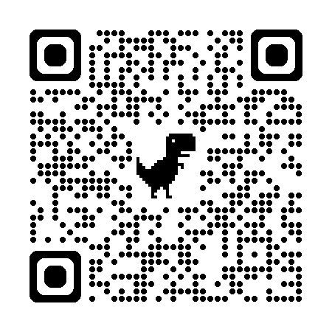
Slides https://github.com/ResearchComputing/debugging_with_linaro_ddt_rc
Notes:
Update with correct github repo Add a QR code for the repo

Slide 5
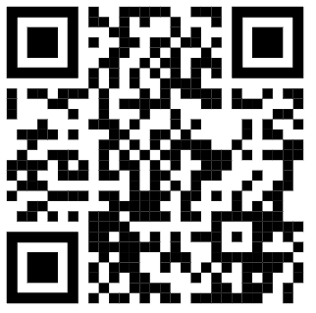
Debugging with VS Code
Instructor:
Research Computing
Website: www.rc.colorado.edu
Helpdesk: rc-help@colorado.edu
Slides:
https://github.com/ResearchComputing/debugging_with_linaro_ddt_rc
Survey:
http://tinyurl.com/curc-survey18
Notes:
Update with correct Github Repo

Slide 6

Overview
Linaro
DDT

Slide 7

Overview
Interactive
Debugger
Linaro
DDT

Slide 8

Overview
Interactive
Debugger
Linaro
DDT
Offline
Debugger
Notes:
ssss

Slide 9
Preparing for Linaro DDT
1. Load modules
ml <compiler> <mpi-library> linaroforge

Slide 10
Preparing for Linaro DDT
1. Load modules
ml intel/2022.1.2 impi linaroforge
2. Compile for debugging
CFLAGS = -O0 -g

Slide 11
Preparing for Linaro DDT
1. Load modules
ml intel/2022.1.2 impi linaroforge
2. Compile for debugging
CFLAGS = -O0 -g
3. Start DDT session
ddt -n <Num-Cores> ./mmult_c

Slide 12

Preparing for Linaro DDT
1. Load modules
ml intel/2022.1.2 impi linaroforge
2. Compile for debugging
CFLAGS = -O0 -g
3. Start DDT session
ddt -n <Num-Cores> ./mmult_c
X16(Max)

Slide 13
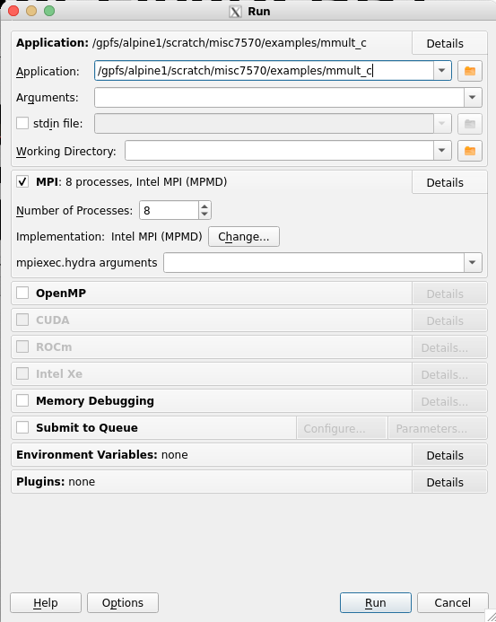
Program Location & Settings

Slide 14
Program Location & Settings
MPI Settings

Slide 15
Program Location & Settings
MPI Settings
Enable Memory Debugging & Profiling

Slide 16
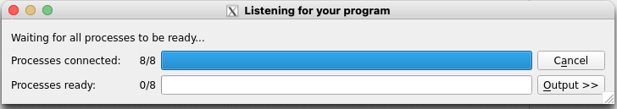
X8

Slide 17
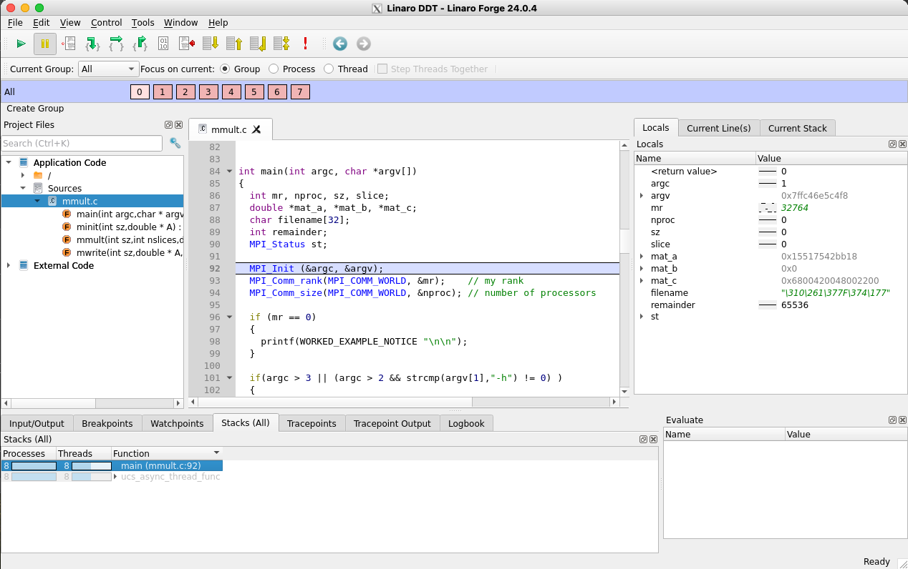
Linaro DDT

Slide 18
1
2
4
3

Slide 19
Debugger
Controls

Slide 20
Debugger
Controls
Code
Editor

Slide 21
Debugger
Controls
Code
Editor
“Point”
Controls

Slide 22
Debugger
Controls
Variables,
Data
Code
Editor
“Point”
Controls

Slide 23

The 3 “points” of Debugging
Breakpoint

Slide 24

The 3 “points” of Debugging
Breakpoint
Watchpoint

Slide 25

The 3 “points” of Debugging
Breakpoint
Watchpoint
Tracepoint

Slide 26
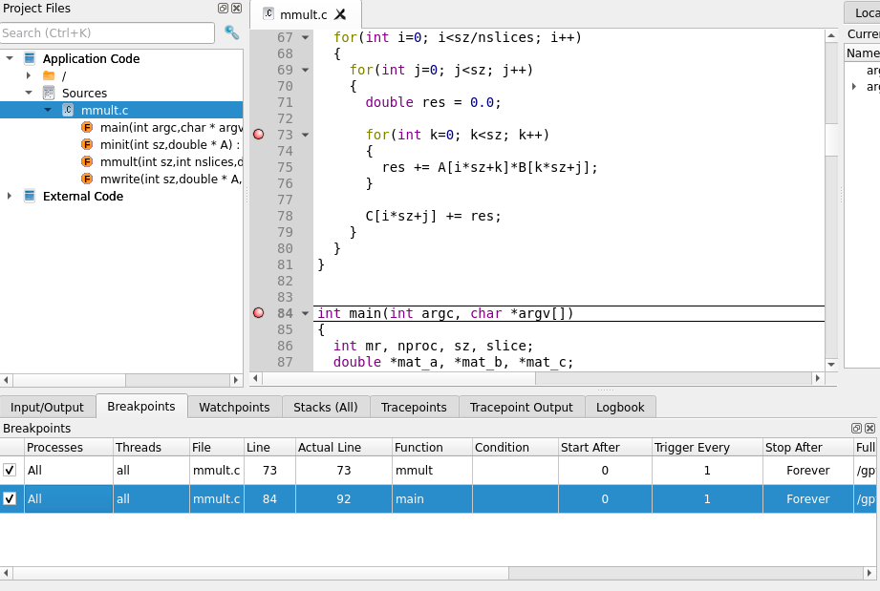
Breakpoints

Slide 27
Breakpoints

Slide 28
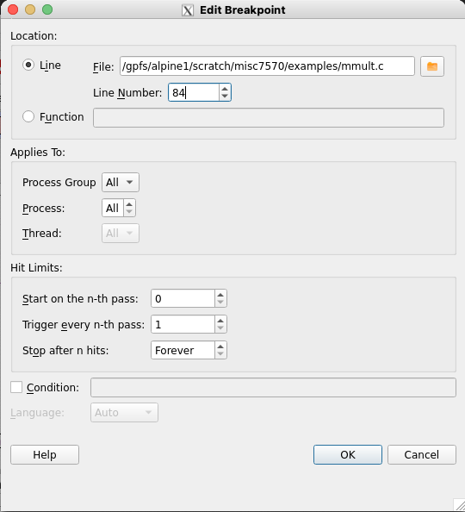
Breakpoints

Slide 29
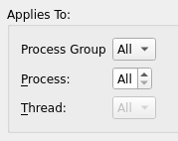
Breakpoints

Slide 30
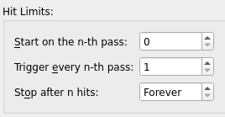
Breakpoints

Slide 31
Breakpoints

Slide 32
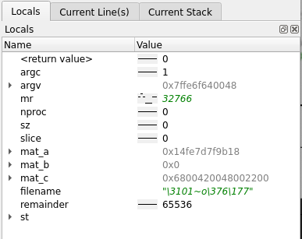
Variable Sparkline

Slide 33
Variable Sparkline

Slide 34
Variable Sparkline
VALUE
PROCESS

Slide 35
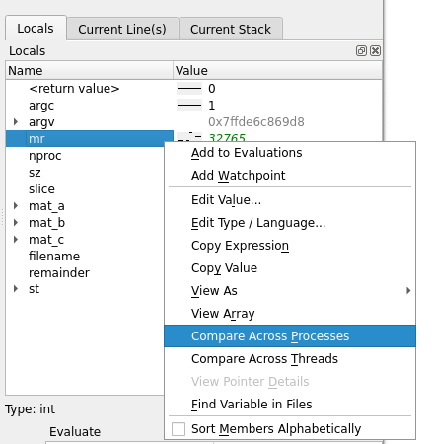

Variable Comparison

Slide 36
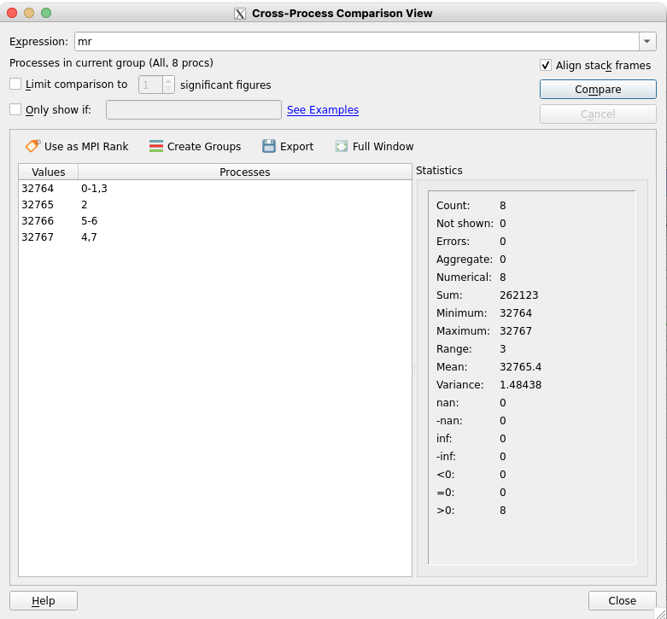
Variable Comparison

Slide 37
Variable Comparison

Slide 38
Variable Comparison

Slide 39
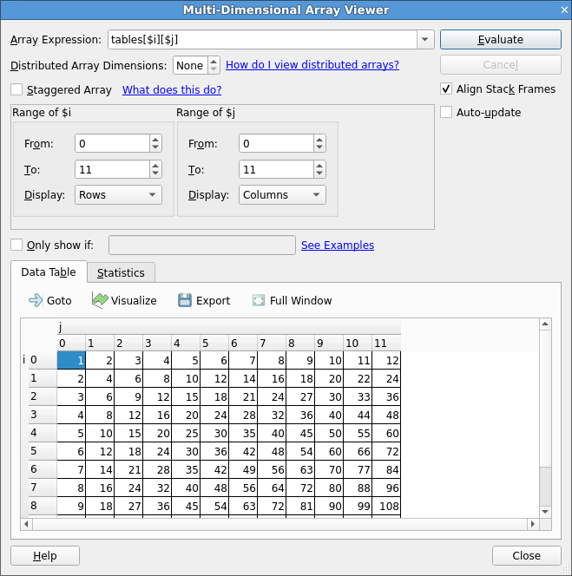
View MD Arrays

Slide 40
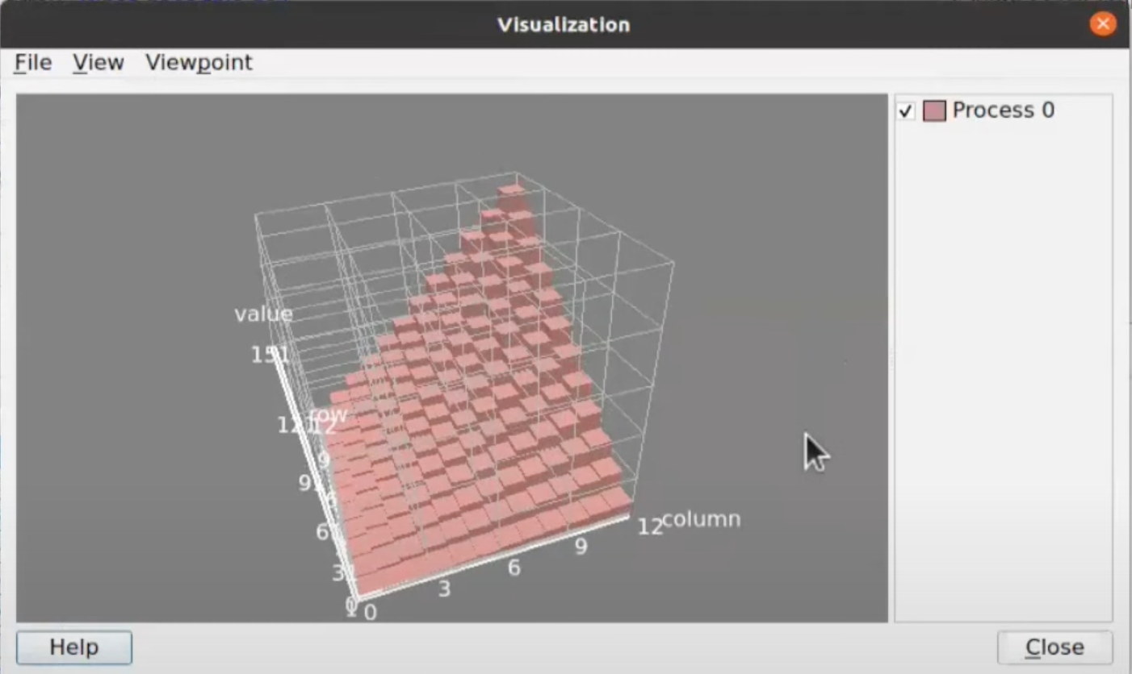
View MD Arrays

Slide 41
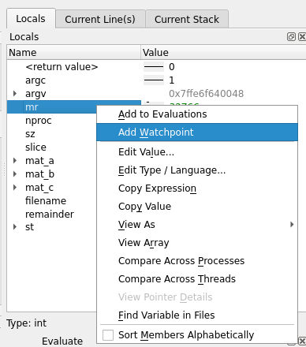
Watchpoints
Notes:
Halt execution based on change to data
Identify where in a program a datapoint is being accessed and/or modified
Only works when the chosen variable is in-scope.
Computationally intensive, be judicious and sparing when creating watchpoints.
*Add in example of watchpoint

Slide 42
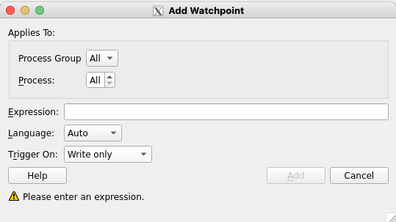
Watchpoints
Notes:
Halt execution based on change to data
Identify where in a program a datapoint is being accessed and/or modified
Only works when the chosen variable is in-scope.
Computationally intensive, be judicious and sparing when creating watchpoints.
*Add in example of watchpoint

Slide 43
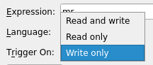
Watchpoints
Notes:
Halt execution based on change to data
Identify where in a program a datapoint is being accessed and/or modified
Only works when the chosen variable is in-scope.
Computationally intensive, be judicious and sparing when creating watchpoints.
*Add in example of watchpoint
Performance Warning – Taken from LinaroForge Documentation:
Modern processors have hardware support for a handful of watchpoints that are set to watch the contents of a memory location. Consequently, watchpoints can normally be used with no performance penalty.
Where the number of watchpoints used is over this quantity, or the expression being watched is too complex to tie to a fixed memory address, the implementation is through software monitoring, which imposes significant performance slowdown on the application being debugged.
The number of hardware watchpoints available depends on the system. The read watchpoints are only available as hardware watchpoints.
Consequently, watchpoints should, where possible, be a single value that is stored in a single memory location. While it is possible to watch the whole contents of non-trivial user defined structures or an entire array simultaneously, or complex statements involving multiple addresses, these can cause extreme application slow down during debugging.

Slide 44
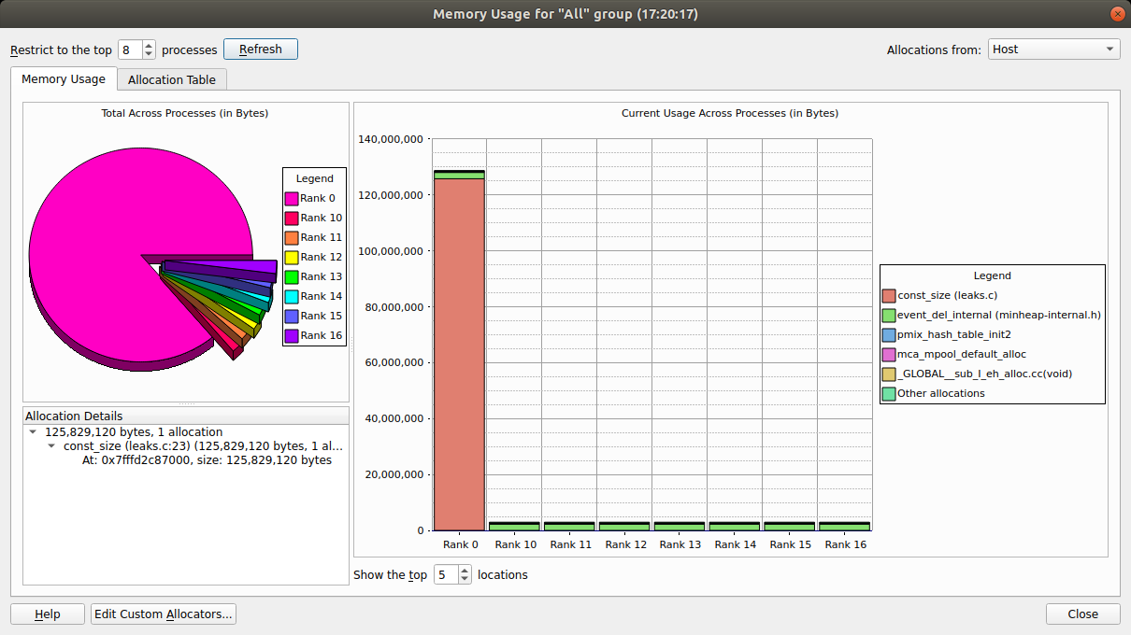
Memory Debugger
Notes:
Helpful for identifying memory leaks.

Slide 45
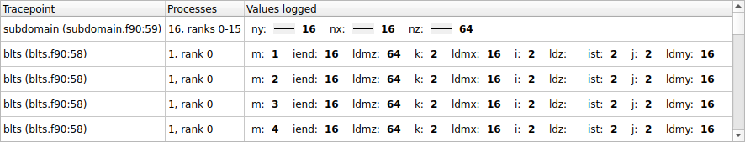
Tracepoints
Notes:
Taken from LinaroForge Documentation: Tracepoints can be particularly useful in these situations, for example:
Recording entry values in a function that is called many times, but crashes only occasionally. If you set a tracepoint it is easier to correlate the circumstances that cause a crash.
Recording entry to multiple functions in a library, enabling the user or library developer to check which functions are being called, and in which order. An example of this is the MPI History Plugin, which records MPI usage. See Use a plugin.
Observing progress of a program and variation of values across processes without having to interrupt the program.

Slide 46
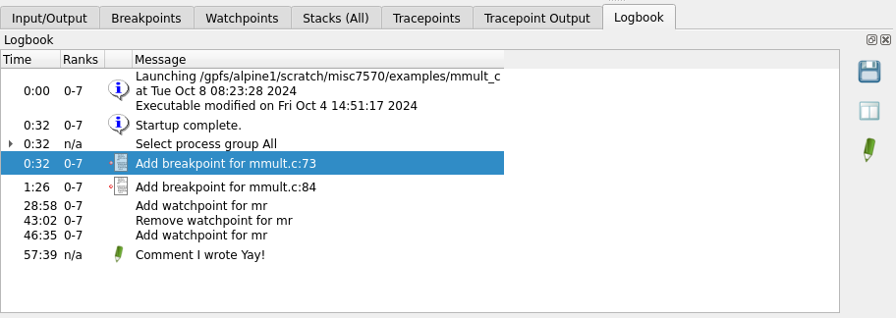
Logbook
Save
Compare
Annotate

Slide 47
When to use each “point”
Breakpoint
Watchpoint
Tracepoint

Slide 48
When to use each “point”
Breakpoint
Watchpoint
Tracepoint
Observe
Code
Location

Slide 49
When to use each “point”
Breakpoint
Watchpoint
Tracepoint
Observe
Code
Location
Observe
Data
Location

Slide 50
When to use each “point”
Breakpoint
Watchpoint
Tracepoint
Observe
Code
Location
Observe
Data
Location
Record
Code
Location

Slide 51
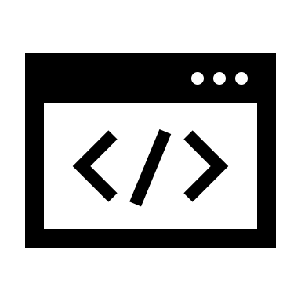
Offline Debugging
$ ddt --offline mpiexec –n <Num-Proc> <Program> <Arguments>

Slide 52
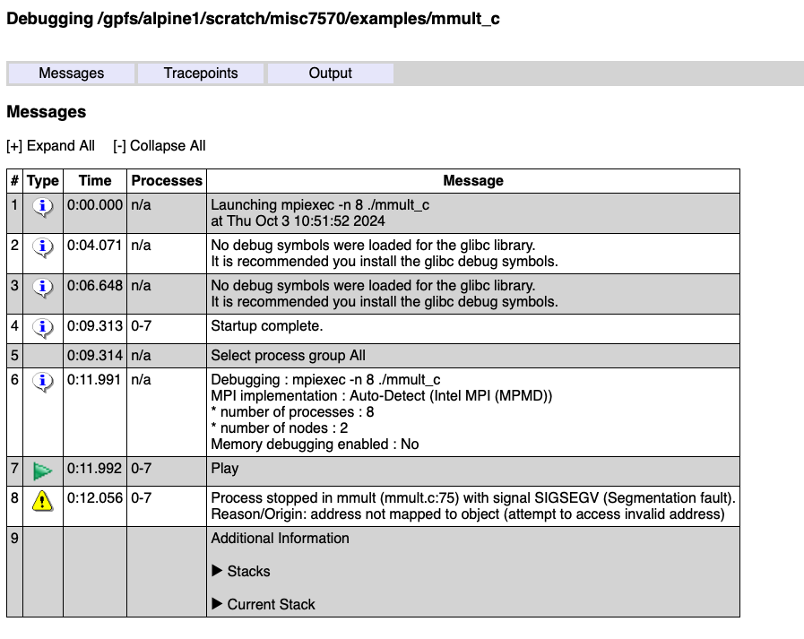
Offline Debugging

Slide 53
Offline Debugging
$ ddt --offline mpiexec –n <Num-Proc> <Program> <Arguments>
Additional Command Line Options: --session=SESSIONFILE
--mem-debug[=(fast/balanced/thorough/off)]
--snapshot-interval=MINUTES
--trace-at=LOCATION[,N:M:P],VAR1,VAR2,...] [if CONDITION]

Slide 54
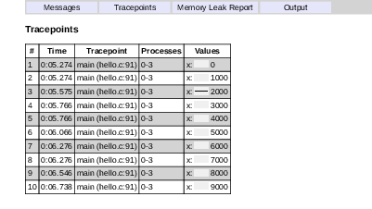
Offline Debugging - Tracepoint

Slide 55
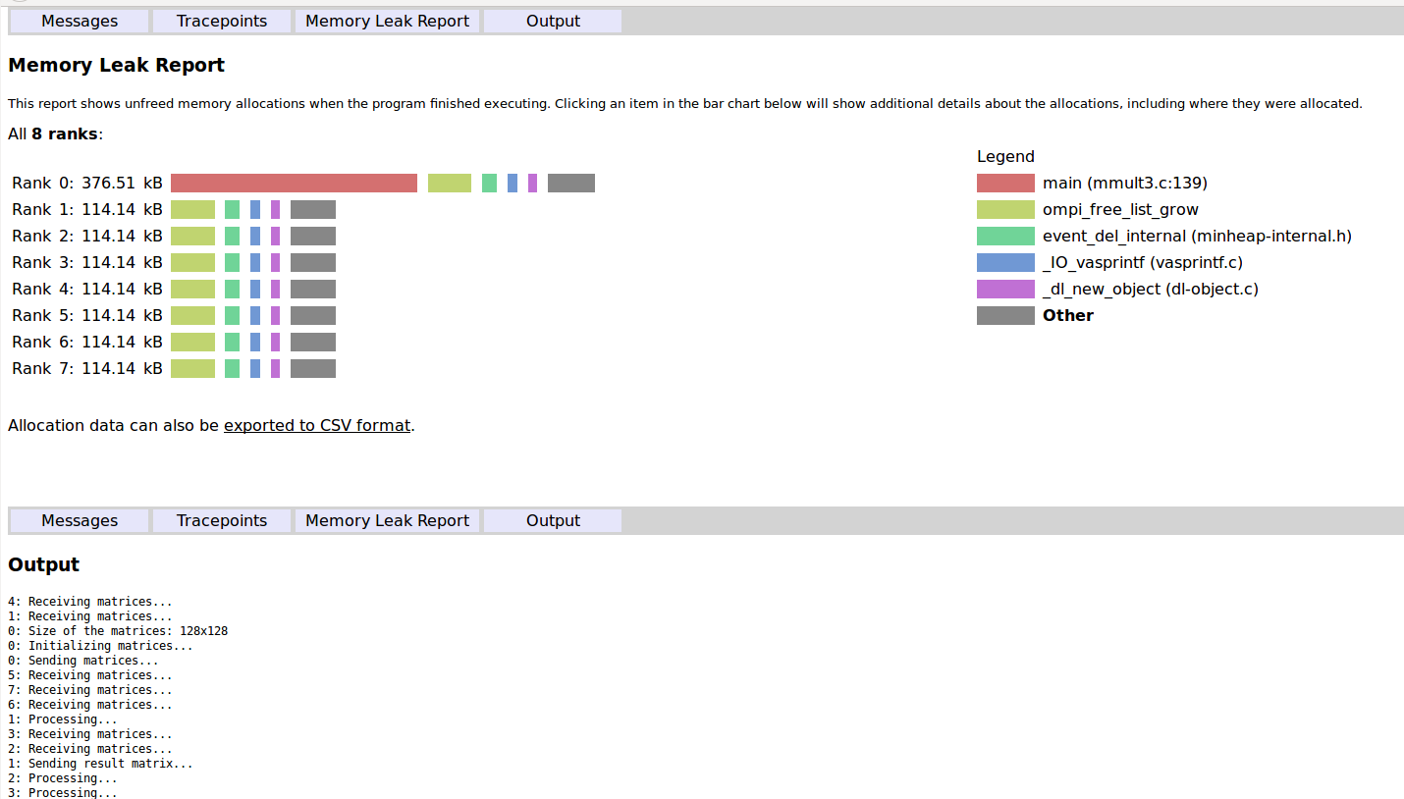
Offline Debugging – Memory Leak

Slide 56
Survey and feedback
http://tinyurl.com/curc-survey18

